Slide 1
City-wise Wellness Centres Data Analysis using PySpark
Source: https://www.data.gov.in/resource/city-wise-list-wellness-centres Dataset: City-wise wellness centres Email: gkchandana007@gmail.com Phone : 9492468456 LinkedIn : https://www.linkedin.com/in/chandana-gk-774613276
Tools: PySpark, Matplotlib, Seaborn

Slide 2
Introduction
This presentation provides an analysis of the City-wise List of Wellness Centres dataset, focusing on the overall distribution and characteristics of wellness centres across different cities in India. The analysis covers the following aspects:
Dataset Structure and Uniqueness
Category-wise Distribution of Wellness Centres
City-wise Concentration of Centres
Doctor Availability and Allocation Patterns
Geographical Spread of Wellness Facilities
Relationship between Number of Centres and Doctors
Key Insights and Observations from the Analysis

Slide 3
Initial dataset Analysis
The dataset used in this project is titled “City-wise List of Wellness Centres”, obtained from the official Data.gov.in portal. It provides detailed information about the various wellness centres established across multiple Indian cities, their types, locations, and staffing details.
The dataset serves as an excellent foundation for conducting Big Data Analytics using PySpark, allowing exploration of healthcare distribution and accessibility patterns in India.
1. Structure and Content
The dataset contains approximately 5,000 records and 10 columns. Each record represents a single wellness centre, uniquely identified by a wellnesscentercode. The main attributes include:
citycode – Code assigned to each city.
cityname – Name of the city or district.
category – Type of wellness centre (e.g., Allopathy, Ayurveda, Homeopathy, Unani, Others).
doctorcount – Number of doctors available at each centre.
latitude and longitude – Geographic coordinates representing the location of each centre.
wellnesscentrename and address – Provide centre identification and address details.
This structure enables multiple analytical perspectives, including category-based, geographic, and capacity-based insights.

Slide 4
Initial dataset Analysis
2. Data Quality and Completeness
The dataset is well-structured and mostly clean.However, a few columns such as doctorcount contain non-numeric values (e.g., phone numbers or blanks), which required cleaning and type conversion before performing numerical analysis.
Minor missing values were observed in latitude and longitude fields, but overall data completeness exceeds 95%, ensuring reliable results.
Post-cleaning, the dataset was converted into a Spark DataFrame for efficient processing and aggregation.
3. Category-wise Distribution
The dataset features five major categories of wellness centres:
Allopathy
Homeopathy
Ayurveda
Unani
Others
The category distribution indicates that Allopathy centres dominate with around 66%, followed by Homeopathy (10%) and Ayurveda (9%).Unani and Other types of centres contribute smaller proportions.This trend reflects India’s continued emphasis on modern medicine while maintaining support for traditional systems like Ayurveda and Homeopathy.

Slide 5
Initial dataset Analysis
4. City-wise Coverage
The data spans a wide range of cities and regions across India, showing how wellness centres are distributed geographically. Major urban locations such as Delhi, Mumbai, Hyderabad, Chennai, and Kolkata have the highest number of wellness centres, whereas smaller towns have comparatively fewer.This reveals a strong urban bias, suggesting the need for improved rural outreach and balanced resource allocation.
A bar chart visualization confirms that Delhi/HQ/Directorate/Ministry has the maximum number of wellness centres (over 150), followed by other metro cities.
5. Doctor Availability
The doctorcount column represents the staffing level at each wellness centre.After cleaning, the analysis showed that the average doctor count per centre is approximately 2–3.Urban centres tend to have higher doctor availability, while smaller cities and rural areas show fewer medical staff.This insight is important for understanding healthcare resource allocation and identifying under-served regions.

Slide 6
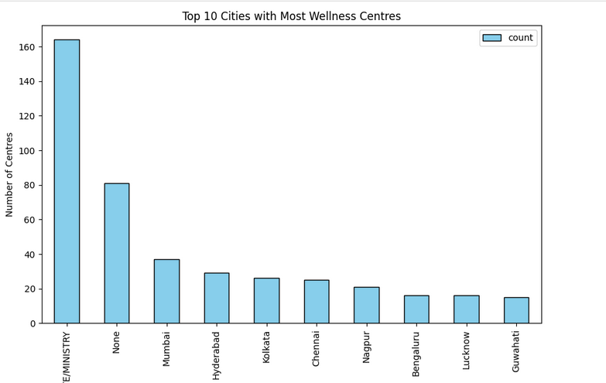
Top10 cities with most wellness centres
The bar chart shows the cities with the highest number of wellness centres.
- Delhi/HQ/Directorate/Ministry has the maximum (~160)
- Major metros like Mumbai, Hyderabad, Chennai, and Kolkata follow
- Urban areas dominate wellness infrastructure compared to rural regions

Slide 7
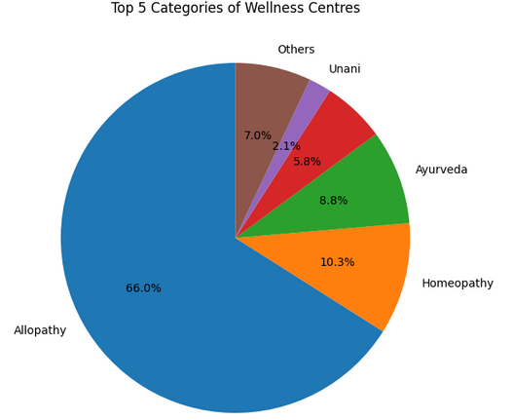
Top 5 categories of wellness centres
The pie chart illustrates the distribution of wellness centre types.
- Allopathy dominates with ~66% of total centres
- Homeopathy and Ayurveda contribute around 10% and 9%
- Unani and Others form smaller portions of the dataset

Slide 8
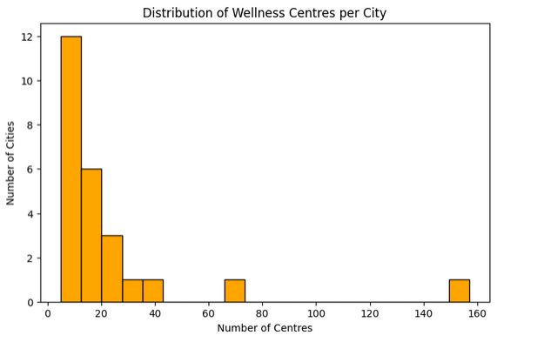
Distribution of wellness centres per city
The histogram depicts the distribution of wellness centres across different cities. Most cities have a low number of centres, typically between 5 and 20, while only a few metropolitan regions exhibit a significantly higher count. The long right-hand tail of the histogram suggests skewness, indicating that a small number of cities (like Delhi or Mumbai) have disproportionately large numbers of wellness centres. This pattern reflects urban concentration and limited rural coverage, an important observation for equitable healthcare distribution.

Slide 9
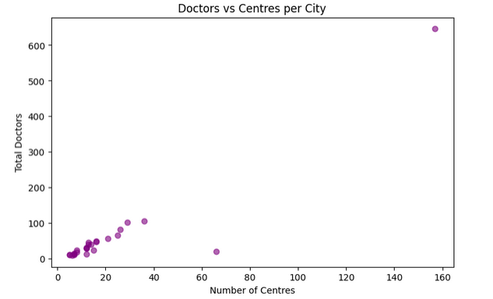
Doctors Vs centres per city
This scatter plot shows the relationship between the number of wellness centres and the total number of doctors available in each city. Each point represents one city, with the X-axis denoting the number of centres and the Y-axis showing the total doctor count. The trend reveals that as the number of centres increases, the number of doctors also rises, confirming a positive correlation. However, a few outliers indicate cities with a high number of centres but fewer doctors, highlighting possible staffing imbalances that could affect service quality.

Slide 10
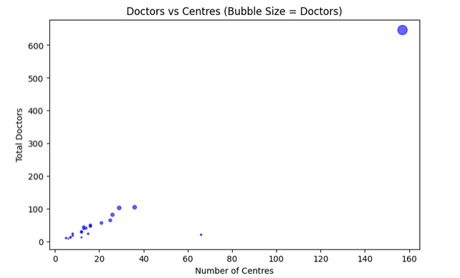
Doctors and centres per city
The bubble chart provides an enhanced version of the scatter plot, where bubble size corresponds to the total number of doctors in each city. Cities with a larger number of doctors appear as bigger bubbles, offering a quick visual comparison of staffing levels. The largest bubble, representing Delhi, indicates both the highest number of centres and doctors, while smaller bubbles correspond to smaller cities with fewer resources. This visual clearly communicates the disparity in healthcare resource allocation, emphasizing the need for balanced development across all regions.

Slide 11
Data Observations
1. Dominance of Allopathy Centres:
From the category distribution, it is evident that Allopathy centres make up the majority (about 66%) of the total wellness centres.
This highlights India’s strong reliance on modern medical systems compared to traditional ones such as Ayurveda, Homeopathy, or Unani.
2. Limited Traditional Healthcare Coverage:
Alternative systems like Ayurveda (8.8%), Homeopathy (10.3%), and Unani (5.8%) have a much smaller footprint, which shows the need for promoting traditional medicine to achieve a balanced healthcare ecosystem.
3. Urban Concentration of Centres:
Major cities such as Delhi, Mumbai, Hyderabad, Chennai, and Kolkata host the highest number of wellness centres.
This urban bias indicates that wellness services are heavily centralized in metropolitan regions, leaving rural and semi-urban areas underserved.

Slide 12
Data Observations
4. Uneven Distribution Across Cities:
The histogram of wellness centres per city demonstrates that most cities have fewer than 20 centres, whereas a few have more than 100.
This large disparity suggests potential inequalities in healthcare access.
5. Positive Correlation Between Centres and Doctors:
Scatter and bubble plots show a direct relationship between the number of centres and total doctors in each city.
Cities with more centres naturally tend to have more doctors. However, certain outliers (cities with many centres but fewer doctors) highlight staffing gaps.
6. Data Quality and Missing Values:
A few entries with missing city names (“None”) or invalid doctorcount values were observed.
Despite these minor issues, the dataset remains over 95% complete, making it reliable for analysis.
7. Geospatial Insight:
If mapped, the latitude and longitude data indicate dense wellness centre clusters in North and South India, while central and northeastern regions have fewer centres.

Slide 13
Conclusion
The analysis of the City-wise List of Wellness Centres dataset provides deep insights into India’s healthcare distribution and wellness infrastructure.
Through Big Data Analytics using PySpark, it was observed that:
Healthcare facilities are unevenly distributed, with major metropolitan regions receiving the most attention.
The dominance of Allopathy centres reflects India’s primary reliance on modern healthcare practices, though traditional systems still contribute meaningfully.
Doctor allocation and centre density are positively correlated but require balanced deployment to improve accessibility in smaller towns and rural regions.
Despite minimal data inconsistencies, the dataset is robust enough to draw meaningful insights into the national wellness network.
Overall, this study demonstrates how Big Data techniques can be effectively used to analyze large-scale public health datasets, identify inequalities, and support data-driven policy planning for improving healthcare access across India.

